Slide 1

Marketing website project of CSE326 project no: 11 COMPUTER SCIENCE AND ENGINEERING SUBMITTED BY: SATYAM YADAV ROLL NO:69 ARIN RAJORA ROLL NO: 2
Submitted to: miss Isha (28828)

Slide 2
introduction
In this project we have made a marketing website through which user can buy products related to their need.
Currently there is a Christmas sale is live where user have access to buy products on very high discounted price.
We also allows user to buy wholesale products in which they get very high discount price on some specific products.
Our login page allows you to become our regular customer.

Slide 3
Features Of The Project
Login page allows the users to login to their respective SHOPPING2GO account.
Home section
Contact box is available
Services
Heavy discount
Search bar
Order Now button available

Slide 4
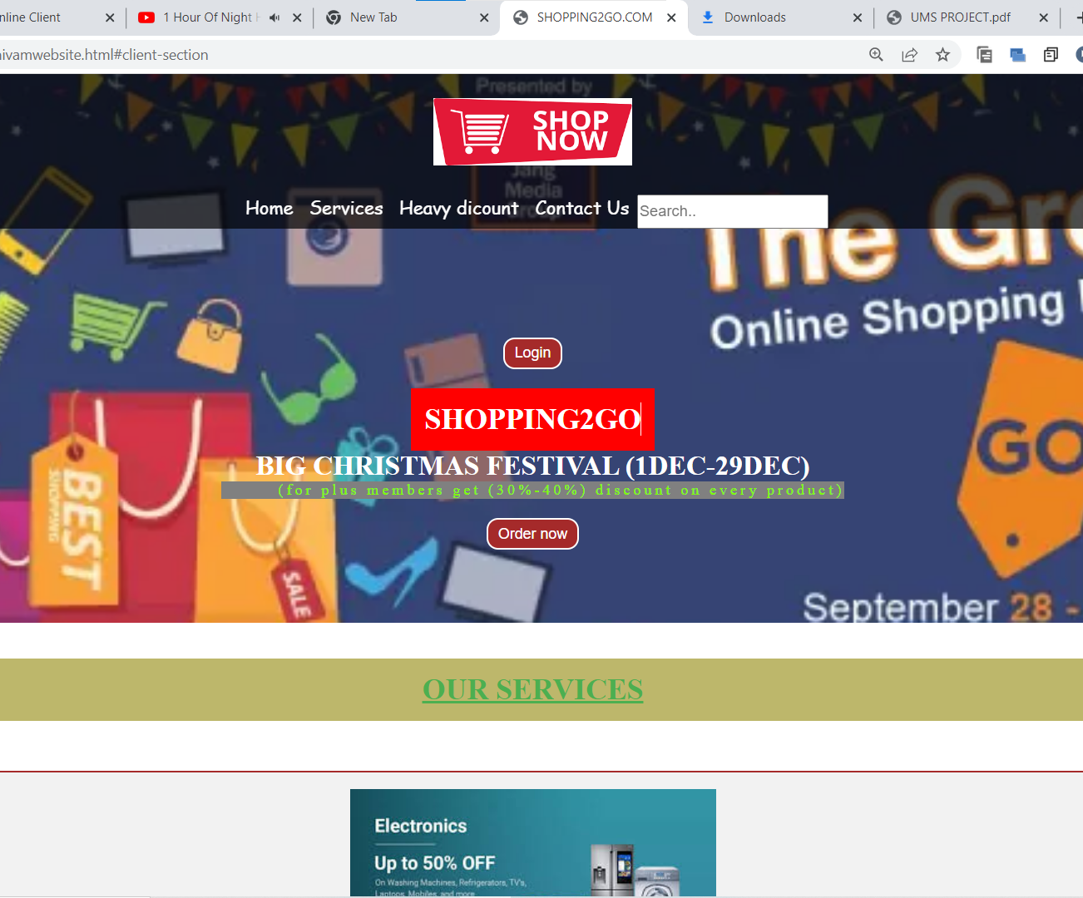
SHOPPING2GO
This the first page of our website.

Slide 5
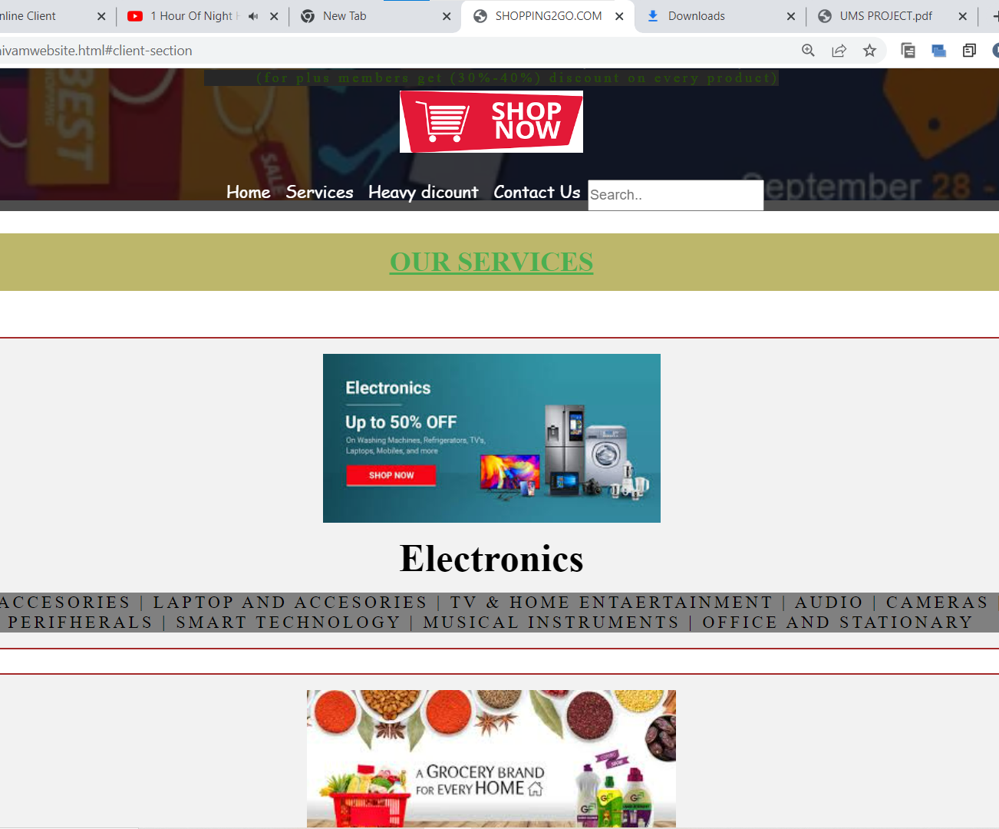
SHOPPING2GO
This the second page that is our services.

Slide 6
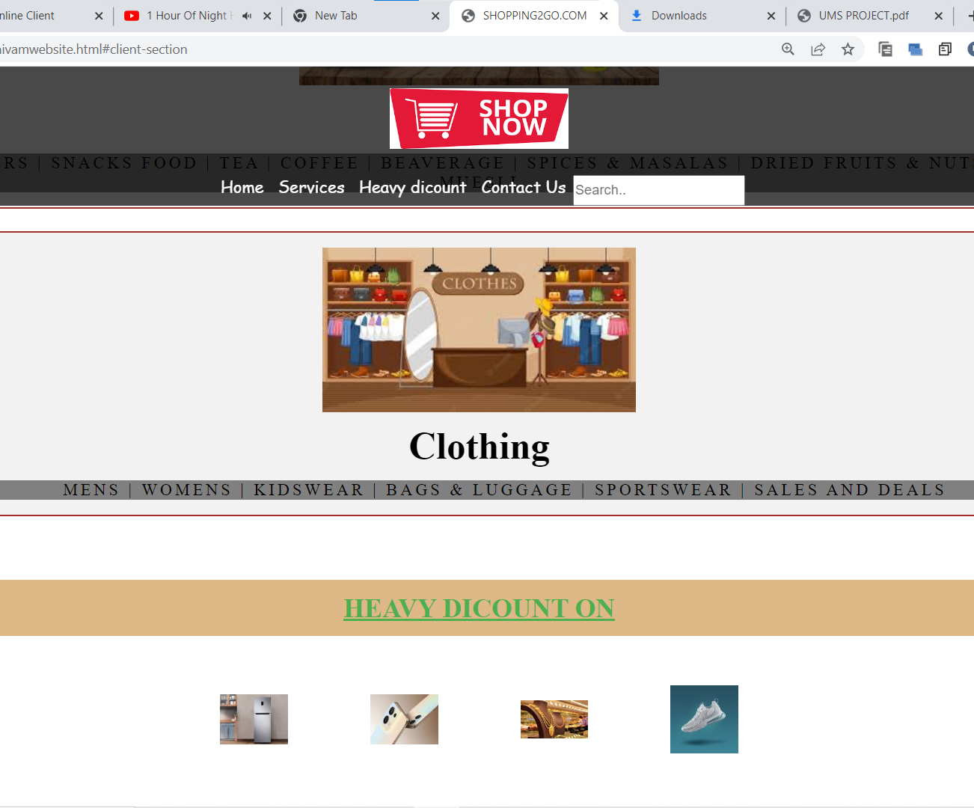
SHOPPING2GO
This is the third page that is related to heavy discounted products.

Slide 7
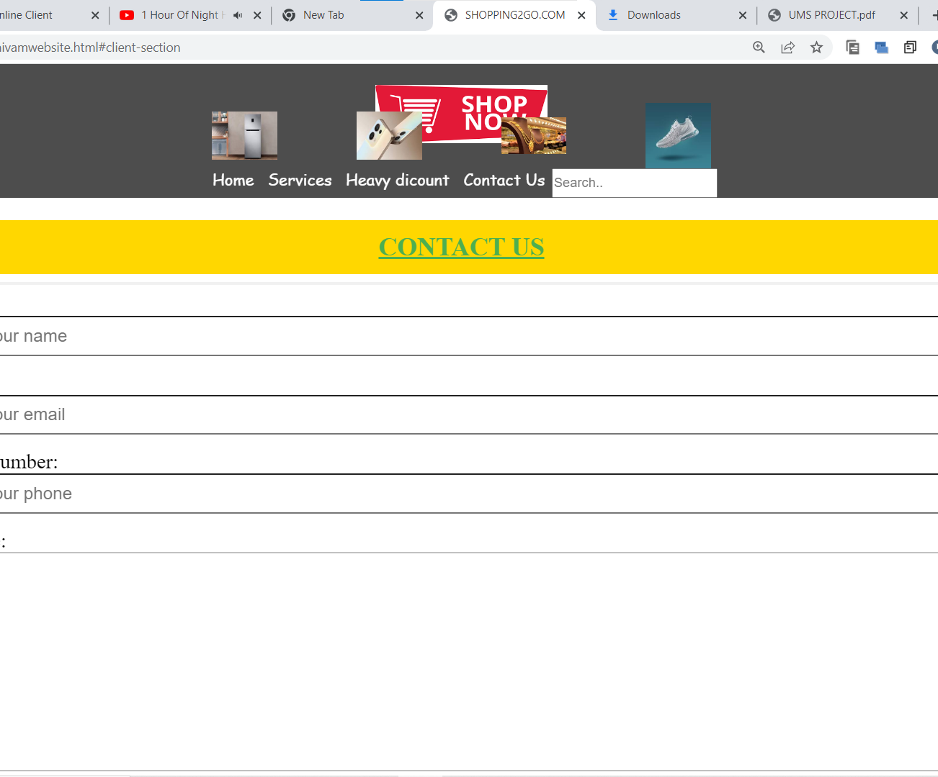
SHOPPING2GO
This is the fourth page that is contact box where user can directly contact with us.

Slide 8
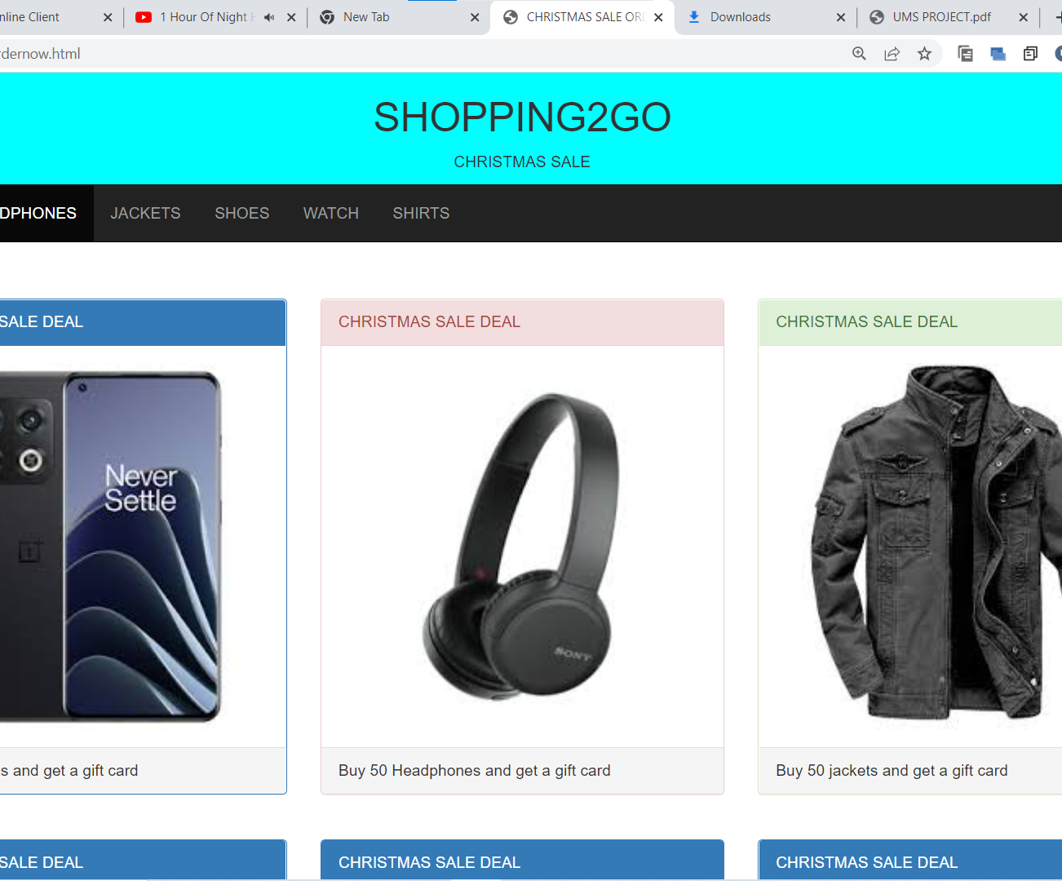
SHOPPING2GO
This this the fifth page that is our Christmas sale is live page where user can buy products on heavy discount.

Slide 9
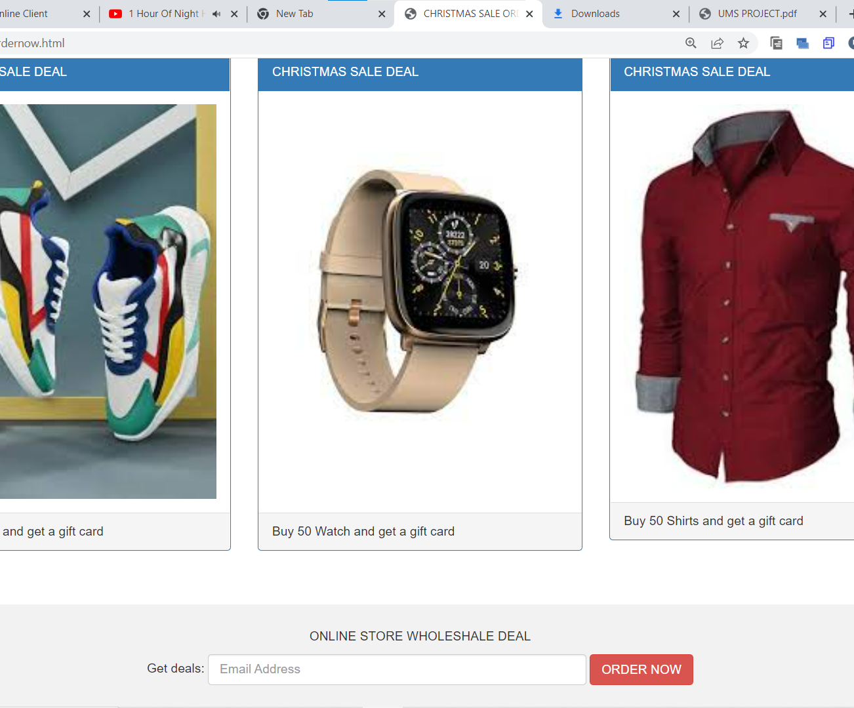
SHOPPING2GO
Our website also provides a special facility that is wholesale product.
Our customers has direct access of whole sale services across India.

Slide 10
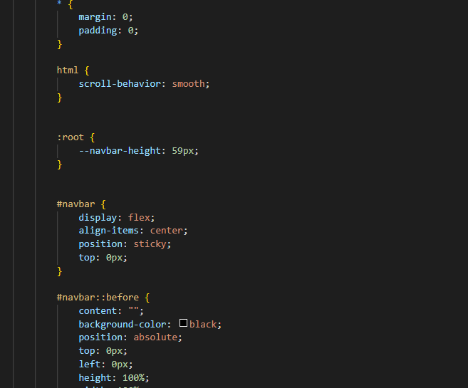
code1

Slide 11
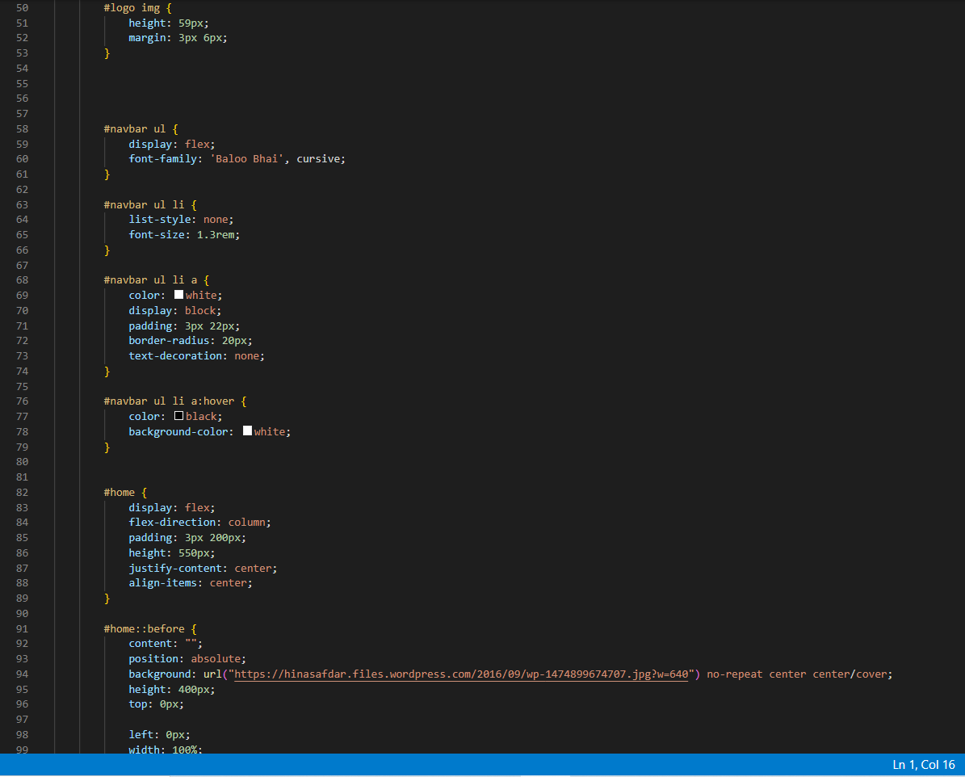
code2

Slide 12
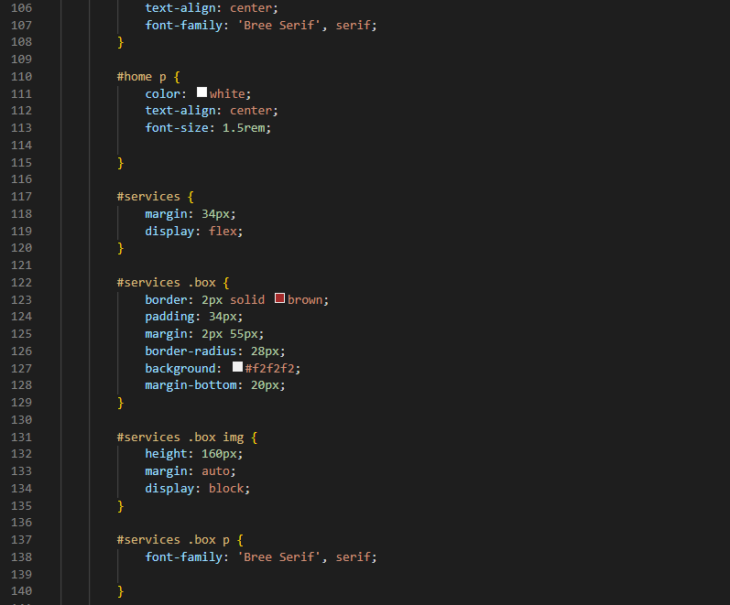
code3

Slide 13
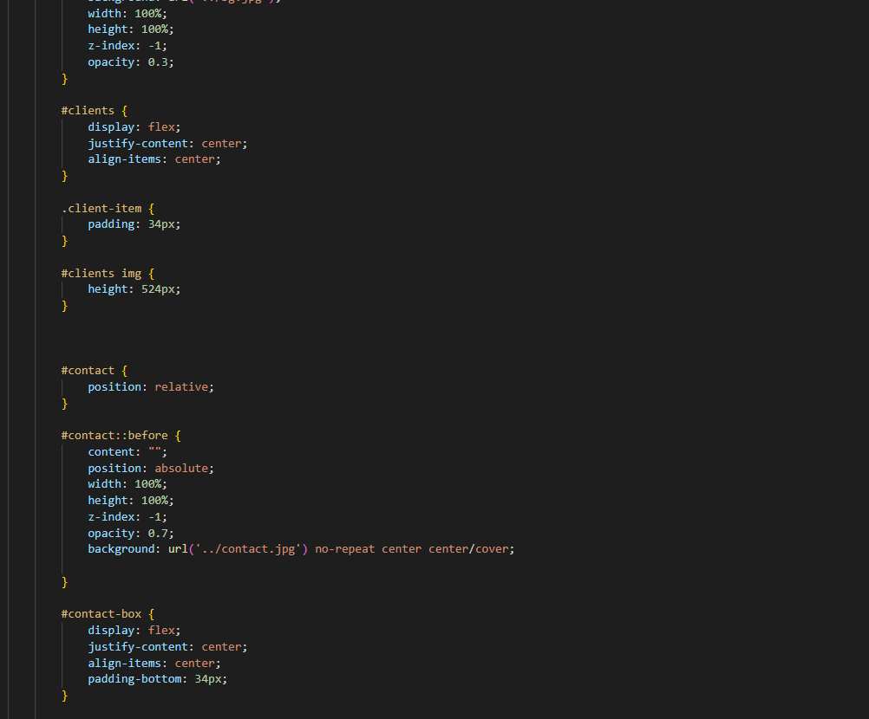
Code4

Slide 14
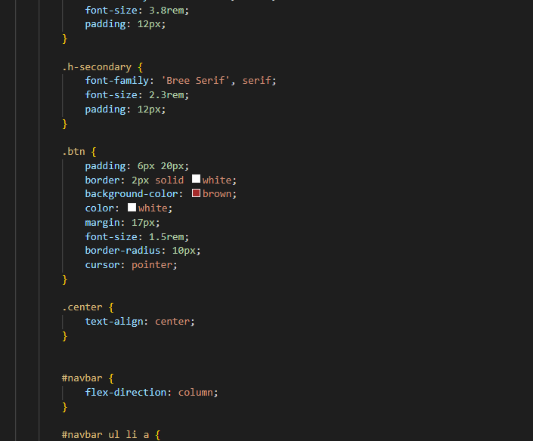
code5

Slide 15
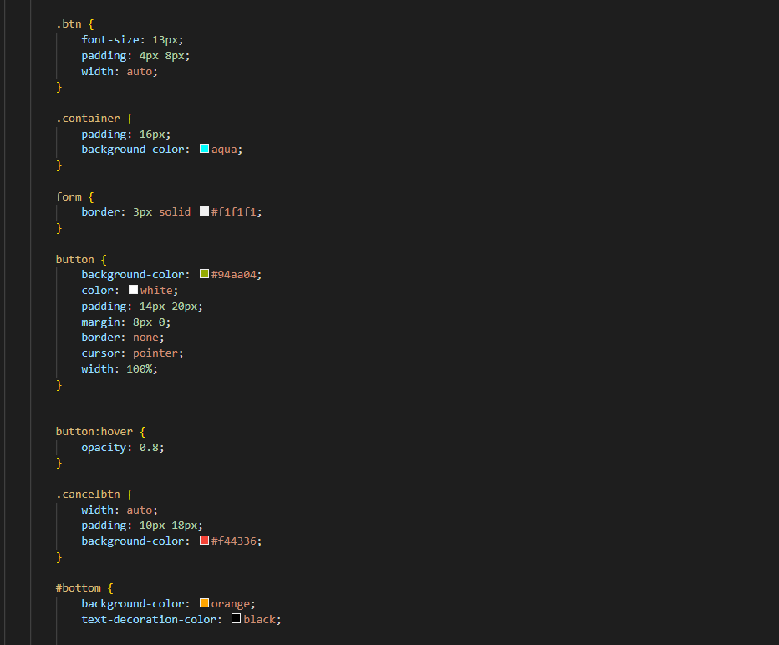
code6

Slide 16
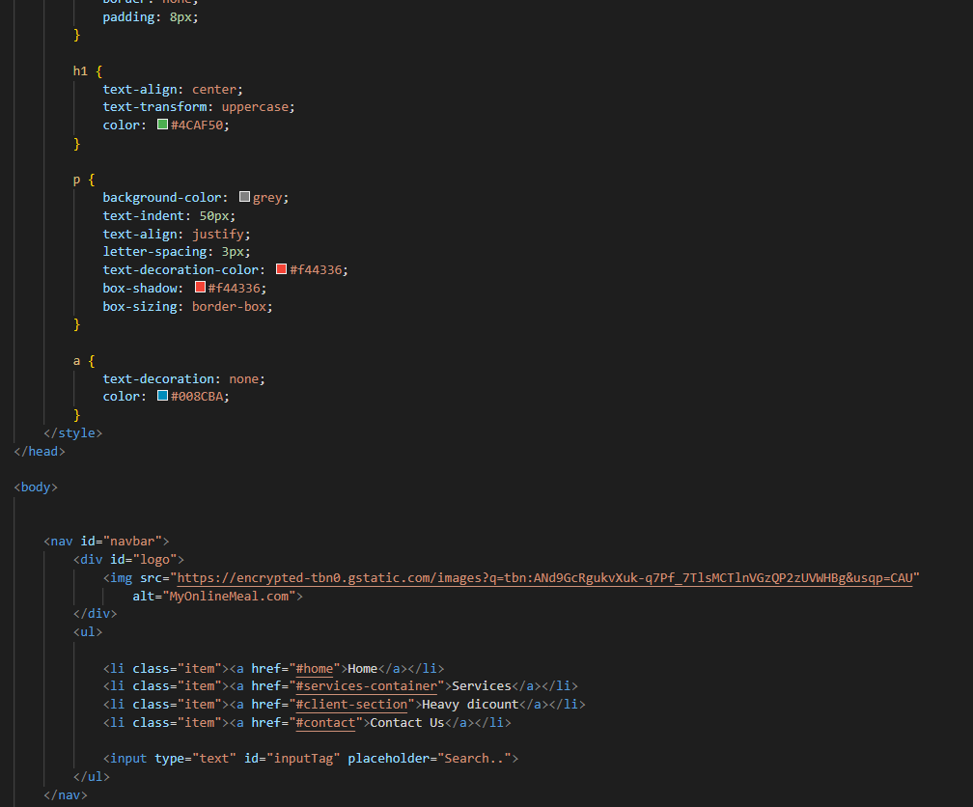
code7

Slide 17
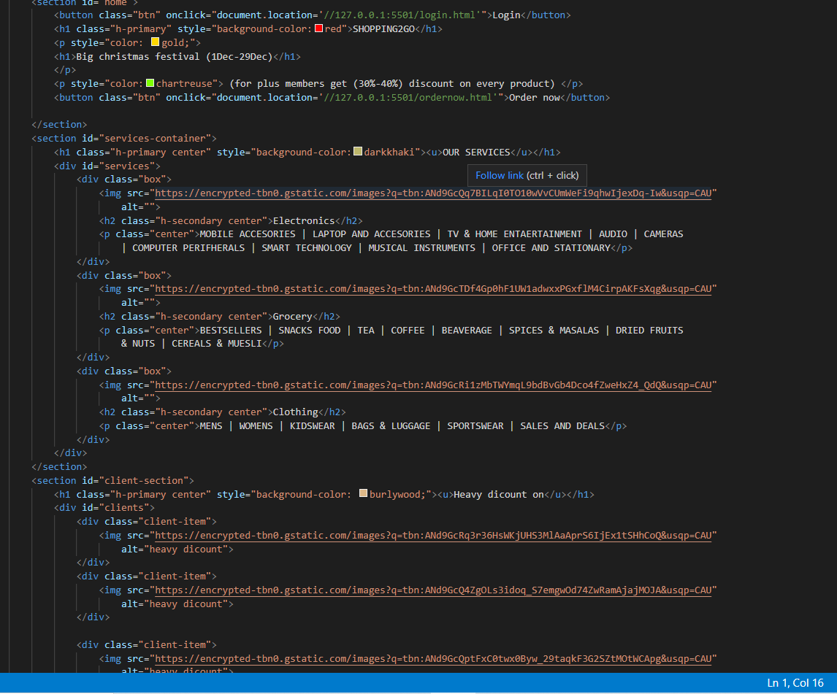
Code8

Slide 18
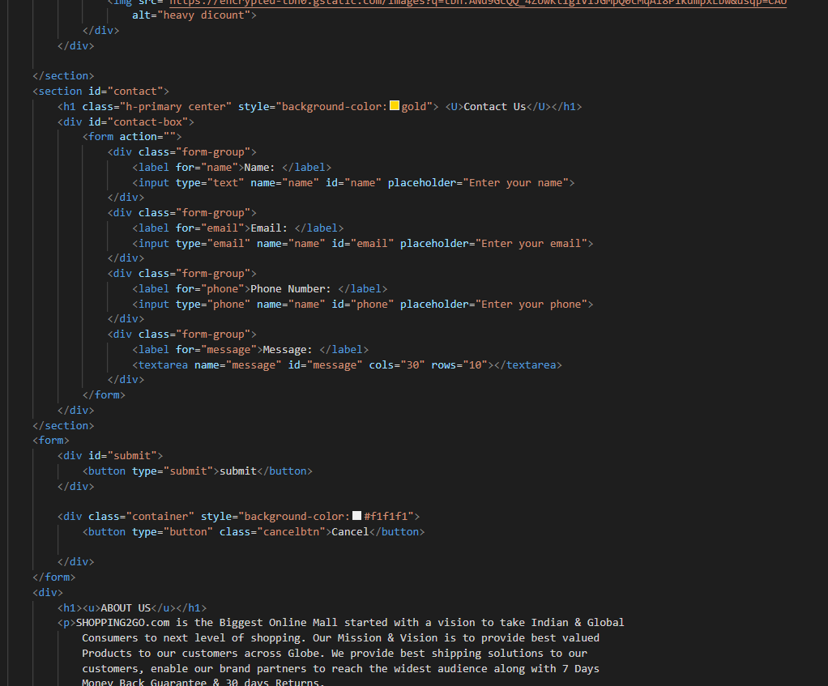
code9

Slide 19
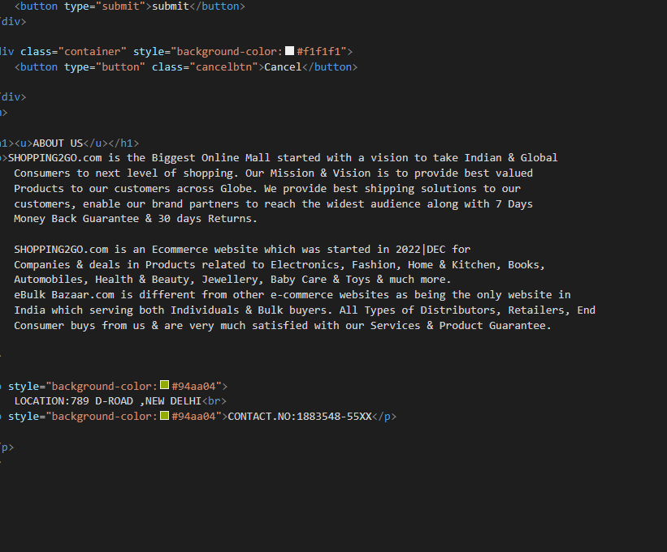
code10

Slide 20
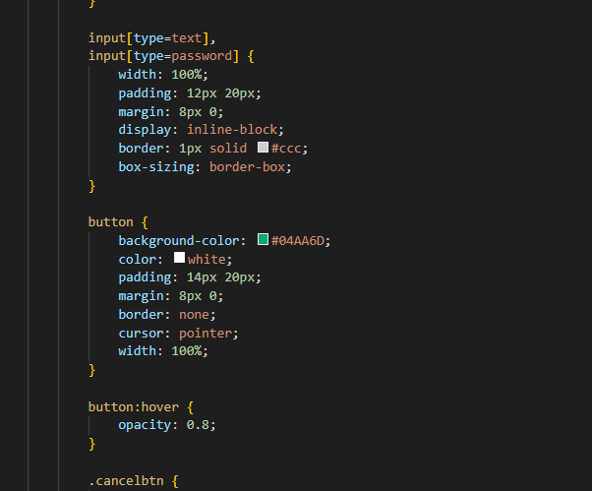
code11

Slide 21
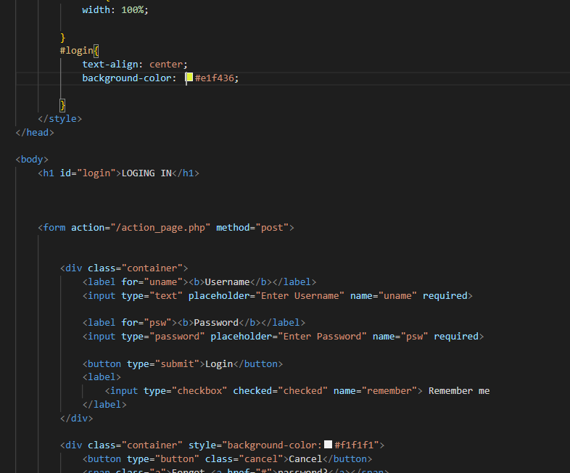
code12

Slide 22
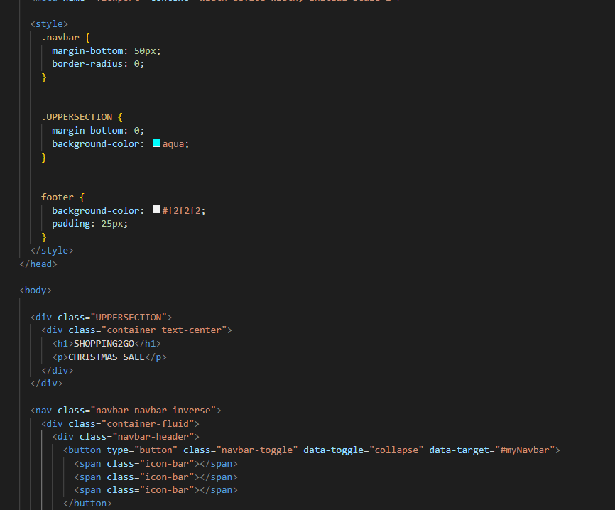
code13

Slide 23
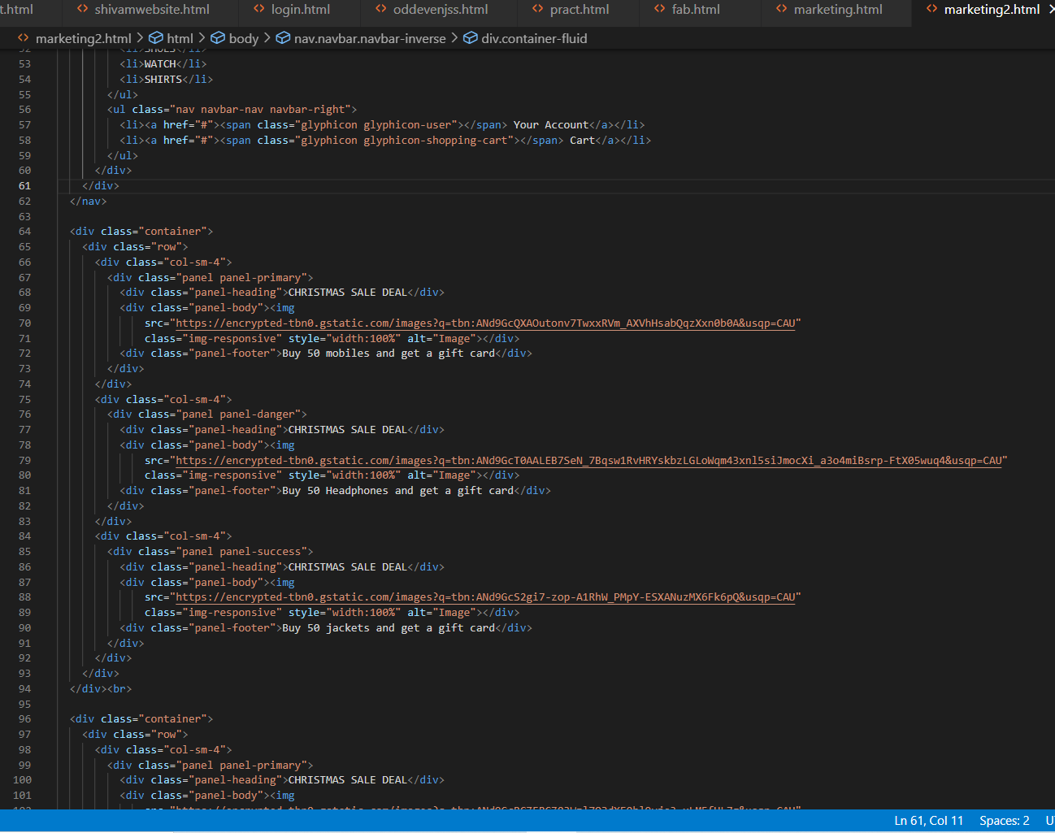
code14

Slide 24
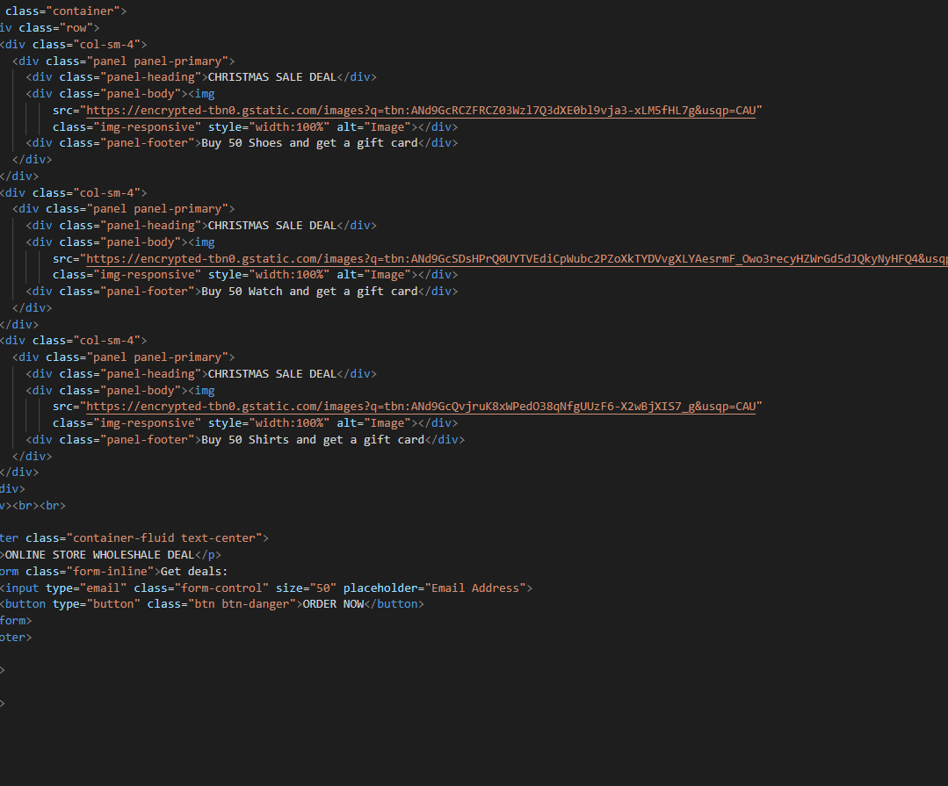
code15

Slide 25
ACKNOWLEDGEMENT
We would like to express special thanks of gratitude to our INTERNET PROGRAMMING CSE326 subject teacher , Miss Isha, who gave us the golden opportunity to work for this project. This project has helped us in doing a lot of research and we came to know about so many things.
I am extremely grateful to all my friends who gave me wonderful suggestions, and criticism which came handy for making of this project.

